Slide 1
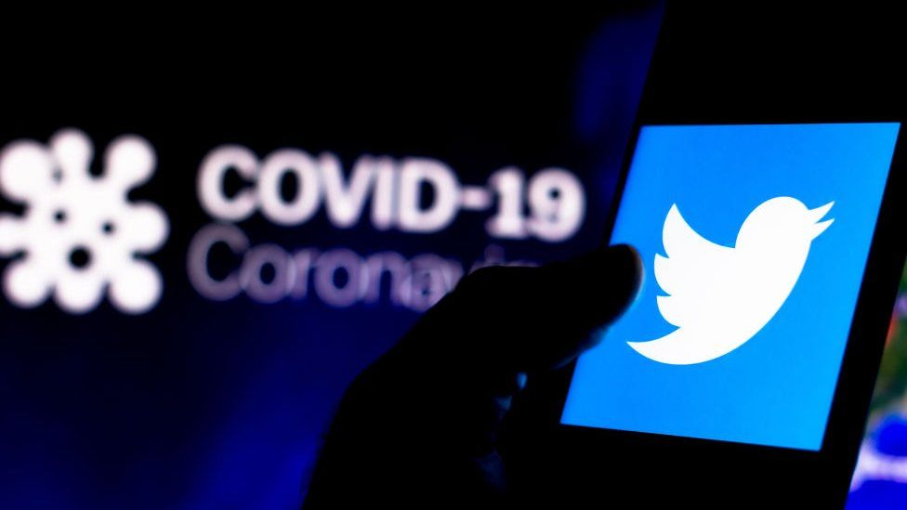
Covid-19 Impact on Twitter in North Carolina
University of North Carolina at Charlotte:
Data Analytics Bootcamp
Project Team: Jimmy White, Lauren Parrish, Mariam Ahmad, Zehra Tokatli, Hector Ladero

Slide 2
The project was designed to assess the impact of Covid-19 on Twitter usage in the state of North Carolina. The team hypothesized that Covid-19 references on Twitter are positively correlated to virus progression. A global baseline was established for early pandemic data and then compared to early North Carolina Covid-19 progression and Twitter activity.
Motivations & Summary:
Questions & Analysis:
Are Covid-19 references on Twitter linked to virus progression both globally and in North Carolina?
Early pandemic global Twitter Covid-19 references fluctuated and were linked to major headline days. As the Covid-19 progressed in NC, the team did see Twitter activity increase in the counties sampled.
2. Does location impact the probability of Twitter use as the virus progressed?
Yes, areas experiencing higher impact from Covid-19 Tweeted, Liked, Retweeted more frequently.
As the number of cases and deaths increased, did Twitter original Tweets increase?
Early pandemic increases in original tweets were linked to headlines, but there was a slow increase regular original Tweets as the virus progressed into late February. TBD – North Carolina Data set
As the number of cases and deaths increased, did Twitter retweets and likes increase?
Yes, as the virus progressed original Tweets did receive a growing number of retweets and likes from the global analysis. The same trend was identified in NC Metropolitan areas.
Is North Carolina a good representation of US COVID-19 trends and what thereby can be inferred about Twitter usage?
North Carolina metropolitan area Twitter trends are likely consistent with those of other metropolitan areas in the US, however, as the team did not sample rural counties, an assessment cannot be made as to whether NC is a good representation of the country as a whole.

Slide 3
Questions & Data:
1) Data from the Twitter API
Data from Twitter was the greatest challenge. Data in the public domain was either applied a cost, was too large, did not provide enough data, or was split into daily data dumps. To capture the data required for the project, a Twitter data scraper was built to retrieve North Carolina data and a Kaggle dataset was used for early global analysis.
2) Data tracking Covid-19 Progression
Covid-19 data was pulled from two Kaggle data sets. One from the WHO which tracked early Covid cases globally and the second from the New York Times which broke cases down by state and county.
3) Geolocation Data from Google
The Google Geolocation API was leveraged to track increases in Twitter usage during March – May 2020 as Covid-19 case and death count increased in North Carolina major metropolitan areas.

Slide 4
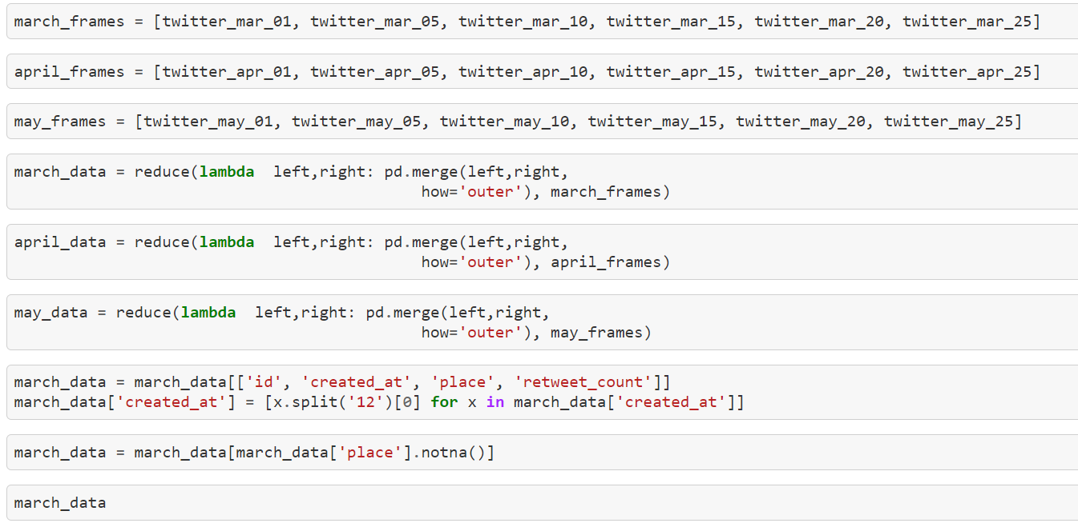
Significant time was allocated to identifying appropriate Twitter datasets . The team struggled to find a “Goldilocks” data set that was not too large, too small, or required a paid API subscription. This culminated with the creation of a data scraper from the Twitter API which pulled tweet information from North Carolina metropolitan areas during March-May 2020. Multiple CSV files were merged and then filtering applied to enable geocoding from the Google API.
Data Clean-Up & Exploration:

Slide 5
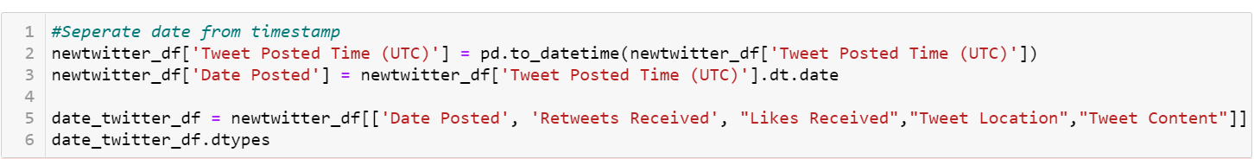
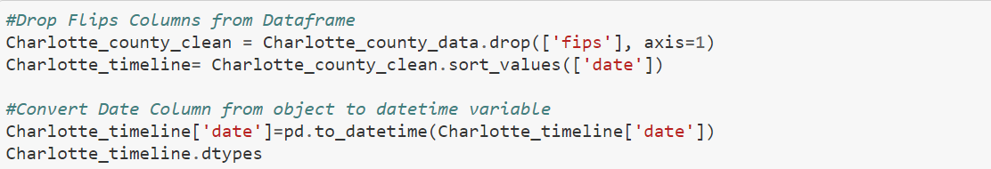
Covid-19 and early Twitter pandemic datasets was cleaner and presented less of a challenge. The team focused on parsing out data that was not required like timestamps and grouping information into usable chunks.
Data Clean-Up & Exploration (cont.):

Slide 6
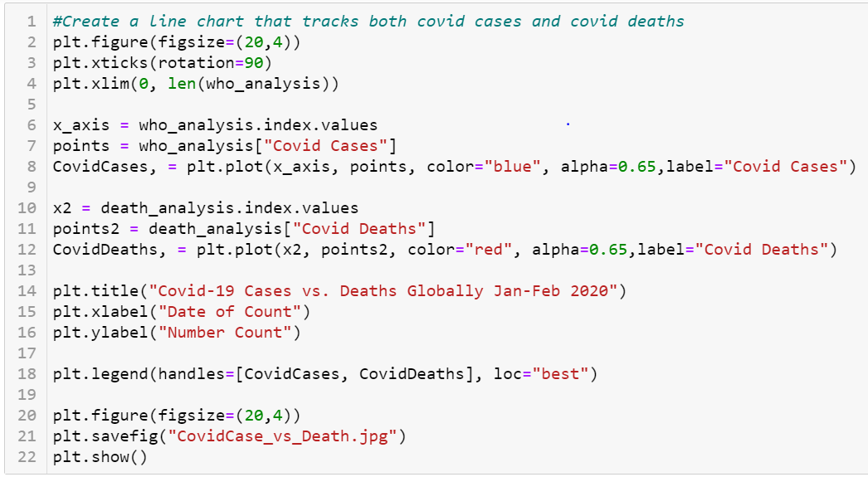
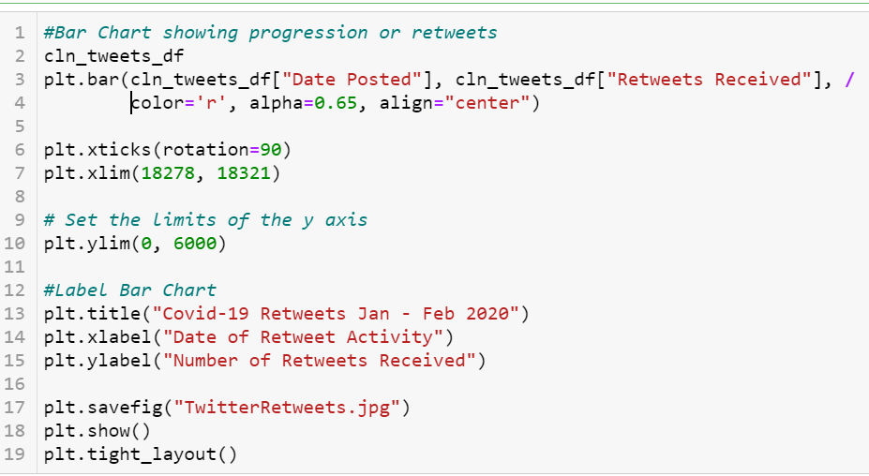
The first step was to determine how to analyze early global Covid-19 data versus Twitter was to decide which graphical representation clearly reflected data trends. The conclusion was that bar chart clearly reflected usage spikes on specific days. The Covid-19 data was then overlayed using a line chart to reflect virus progression.
Data Analysis:
Early Global Covid-19 Progression vs. Twitter:

Slide 7
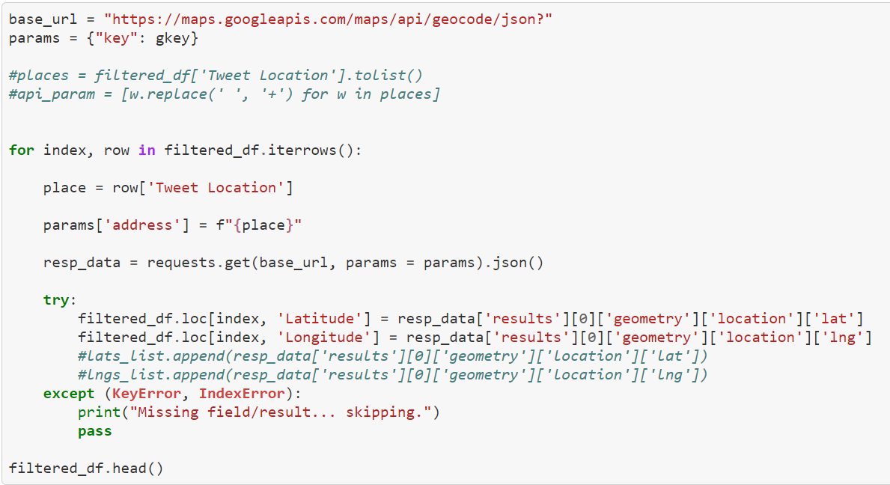
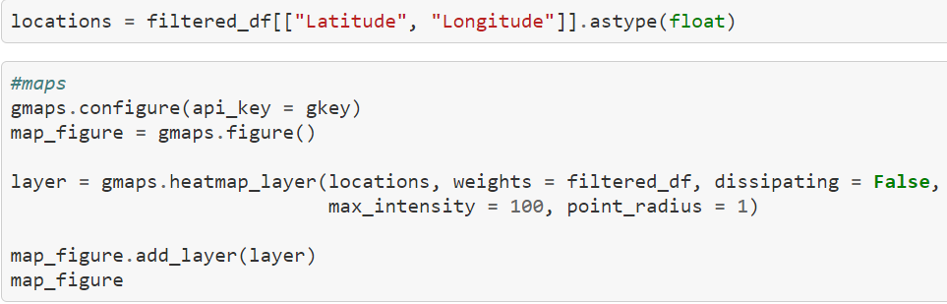
Data Analysis (cont.):
North Carolina Covid-19 Progression vs. Twitter Activity:
Twitter activity across major North Carolina population centers was then assessed the Twitter API and Google API to create tweet activity heatmaps. This was then compared to the Covid-19 progression data set.

Slide 8
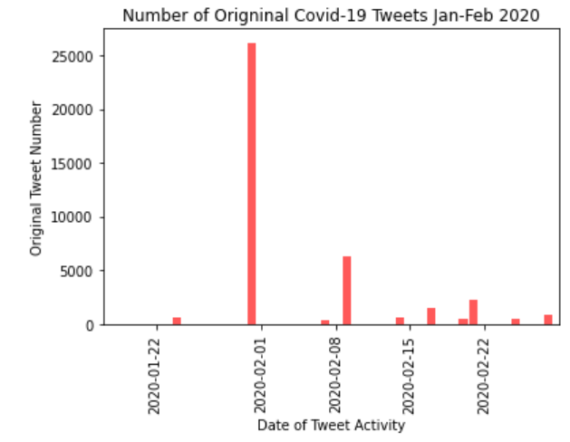
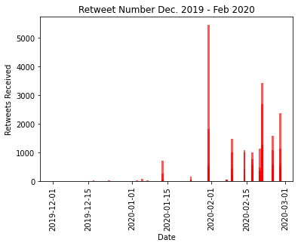
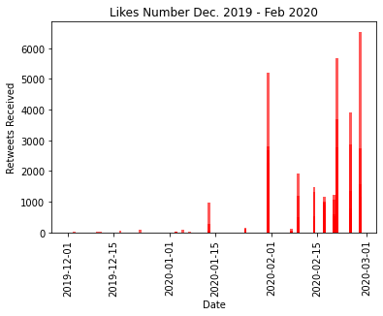
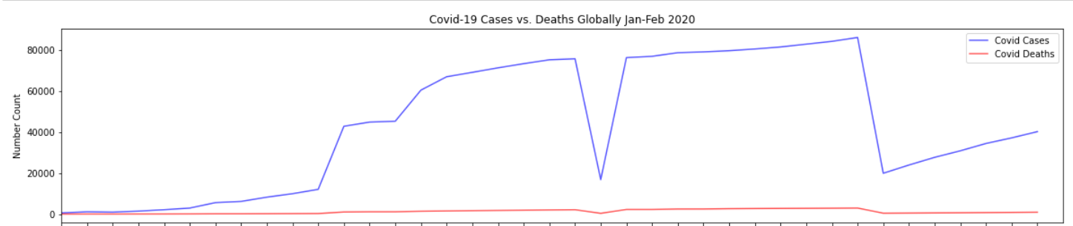
Discussion: Twitter Activity vs. Covid-19 Progression: Global Analysis

Slide 9
Discussion (cont.): Twitter Activity vs. Covid-19 Progression: Global Analysis
Observations:
During the early stages of the pandemic, Twitter data globally did not see a steady increase in original tweets as expected. Instead, higher numbers of original tweets occurred on days when there were major world headlines. Clear examples occurred on January 31st when the US announced travel restrictions for visitors returning from China and when the first quarantines were initiated. Similar headline grabbing announcements occurred on February 9th, 2020 (China investing10bn to fight the virus) and on February 21st (WHO announced that Covid-19 was officially a pandemic).
News cycles have significant impact on original tweets rather than sustained but increasing information such as what was experienced in the early part of the Covid-19 pandemic.
2) “Likes” and “Retweets” differed slightly. There were still peaks on days which correlated to major headlines, but as the virus progressed, “Likes” and “Retweets” reflected more stable forward progression as expected. Also, the comparison between “Likes” and “Retweets” reflects that Twitter users are more inclined to like rather than retweet.
As awareness of a topic, like Covid-19, grows, Twitter users are more likely to be involved in that topic. This corresponds to more tweet “Likes” and “Retweets.”

Slide 10
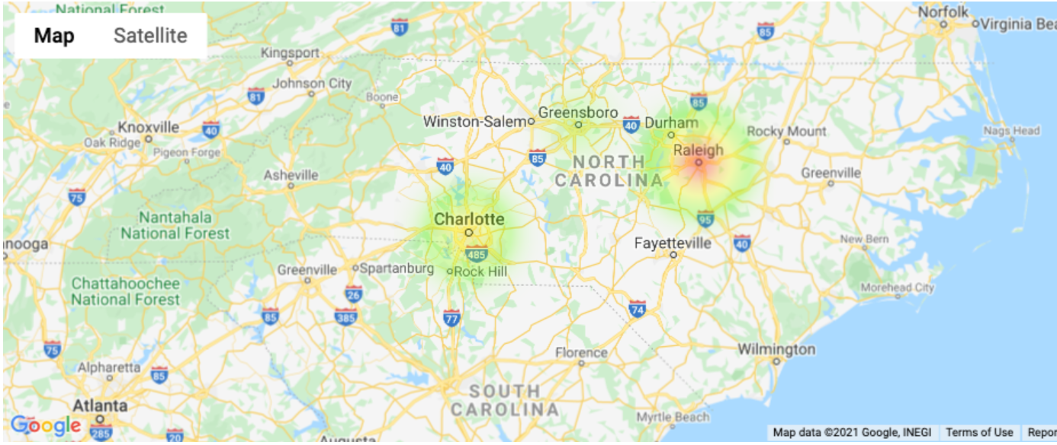
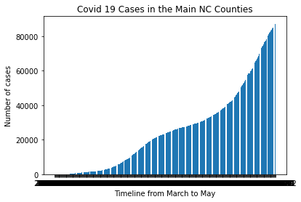
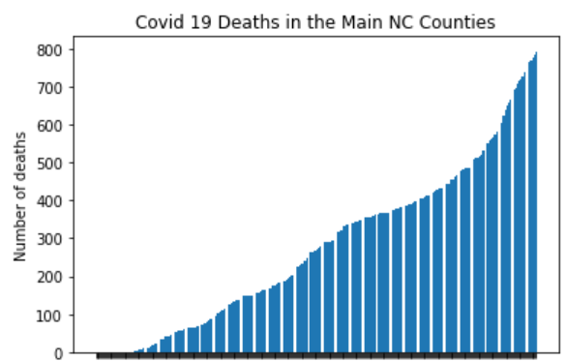
Discussion (cont.): North Carolina Twitter Activity vs. Covid-19 Progression
March Twitter Activity:
April Twitter Activity:

Slide 11
Discussion (cont.): North Carolina Twitter Activity vs. Covid-19 Progression
Observations:

Slide 12
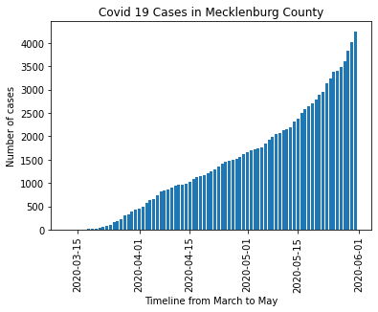
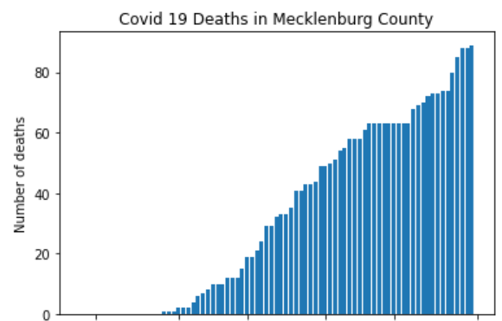
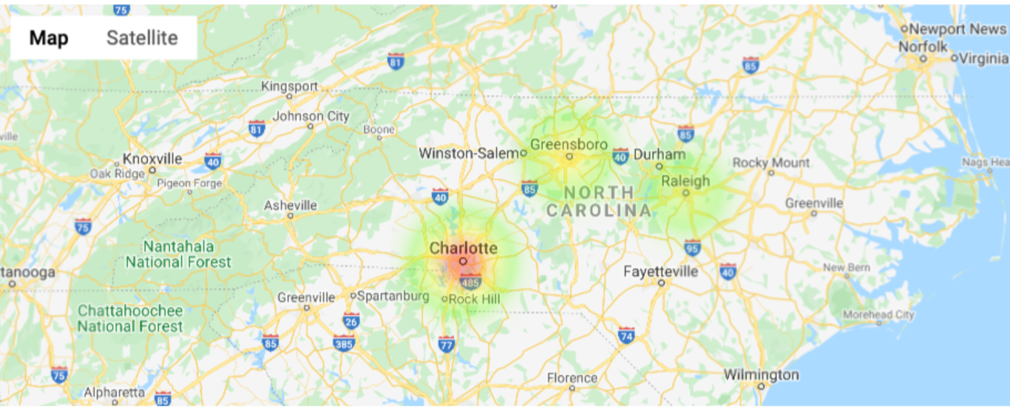
Discussion (cont.): North Carolina Twitter Activity vs. Covid-19 Progression
Observations:
A The data reflected that Mecklenburg County’s Covid-19 cases maintained a similar distribution to other North Carolina Metropolitan areas, however, they experienced a sharper increase in death rates. This differed from Wake county where Twitter activity declined, and Covid-19 cases and deaths were not as significant.
The increase in death rates aligned with increased Twitter activity. This behavior is aligned to the team’s hypothesis that Twitter activity increased as the pandemic progressed.
Tweets by Location in May 2020:

Slide 13
Postmortem:
Challenges:
Scope: Initially, the team wanted to pull in multiple social media providers to assess if Covid-19 increased usage of social media. Additionally, the team wanted to use a year’s worth of pre-Covid social media use as a baseline and a year’s worth of Covid-19 social media use. It quickly became apparent that this was too large a data set.
Data Retrieval: The team struggled to retrieve a sufficient data set from a social media provider. Some of the data we wanted to leverage, such as geolocations, required paid for services. This required the team to look for alternative data points. Often these data points required significantly more cleaning. Additionally, the social media providers had several restrictions due to data privacy as to what could and could not be used.
Deeper Dive:
If we compared Twitter to another social media provider, would our findings be consistent?
Would we see similar trends in the Twitter data if we included rural counties.
3. Is Covid fatigue now having an impact on tweeting activity?

Slide 14
QUESTIONS?

Slide 15
Appendix – Additional Graphical Representations of Data

Slide 16
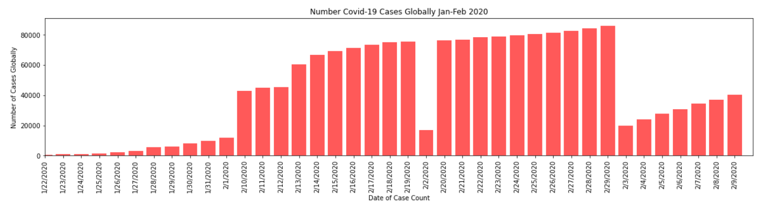
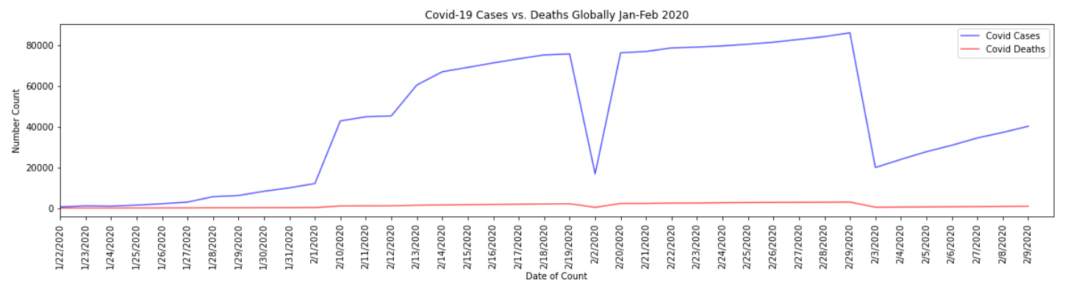
Global Progression in Covid-19 Cases

Slide 17
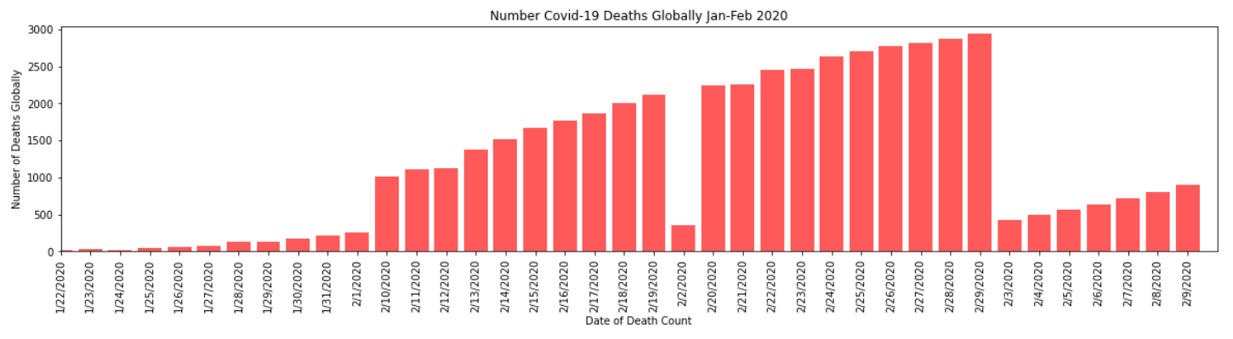
Global Progression in Covid-19 Deaths

